Slide 1
ISB 120
(Ph.D WIP, LECTURER NAME:
MULENGA MPOLOKOSO
(Ph.D_WIP, MBA, BBA, BICTED, BSCFO, TM, ISP, CMP)

Slide 2
Unit 3: Consumer Behavior and Utility Analysis
⦁ Utility and preferences: understanding consumer choices
⦁ Budget constraints and consumer choice
⦁ The concept of consumer surplus: its significance and calculation
⦁ Income and substitution effects in response to price changes
⦁ Applications of elasticity in consumer behavior analysis
⦁ Revealed preference theory and consumer demand
⦁ Behavioral economics insights into consumer decision-making
⦁ Ethical considerations in advertising and consumer choices
⦁ The role of consumer psychology in marketing strategies
⦁ The impact of technological advancements on consumer behavior

Slide 3
Total Utility, Marginal Utility, Law of Diminishing Marginal Utility
The term “utility” refer to the satisfaction or benefit that a consumer derives consumption of the commodity. The utility can be measured in utils.
Utility analysis, attempts to explain consumer behaviour, on the basis of satisfaction derived from the consumption of commodities.
Ofcourse, the utility derived from the consumption affects the consumer's purchase and consumption decision.

Slide 4
TYPES OF UTILITY
Generally, Utility means “Usefulness”.
In Economics, Utility is defined as the power of a commodity or a service to satisfy the human wants.
1. TOTAL UTILITY:
It refers to the sum of utilities of all units of a commodity consumed. For example, if a person consumes ten apple, then the total utility is the sum of satisfaction of consuming all the ten apple.
2. MARGINAL UTILITY:
Marginal Utility is addition made to the total utility by consuming one more unit of a commodity.
Example: if a person consuming 10 apples, the marginal utility is the utility derived from the 10th unit (or) last unit.
MUn=TUn-TUn-1

Slide 5
FORMULA
Total Utility (TU). = U1 + U2 +U3 + ------- + Un
Marginal Utility = Δ 𝑖𝑛 𝑇𝑜𝑡𝑎𝑙 𝑈𝑡𝑖𝑙𝑖𝑡𝑦/Δ 𝑖𝑛 𝑄𝑢𝑎𝑛𝑡𝑖𝑡𝑦 𝐶𝑜𝑛𝑠𝑢𝑚𝑒𝑑
Relationship between Total Utility and Marginal Utility
i. When marginal utility is positive, total utility increases.
ii. When marginal utility is zero, total utility reaches maximum.
This is called point of satiety.
iii. When marginal utility is negative, total utility declines

Slide 6
DIAGRAM SHOWING RELATIONSHIP BETWEEN TU, MU AND UNITS CONSUMED
Units of Goods Consumed | Total Utility (TU) | Marginal Utility (MU)
1 | 6 | 6
2 | 10 | 4
3 | 12 | 2
4 | 12 | 0
5 6 | 10 6 | -2 -4

Slide 7
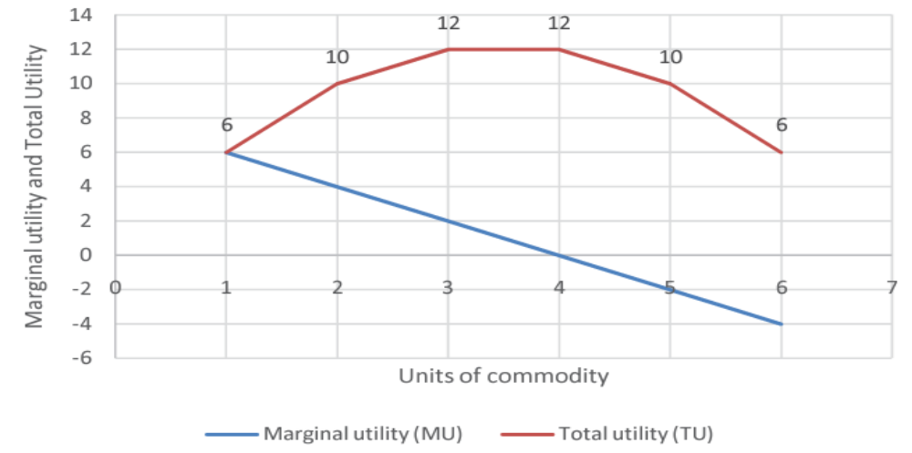
DIAGRAM SHOWING RELATIONSHIP BETWEEN TU, MU AND UNITS CONSUMED

Slide 8
LAW OF DIMINISHING MARGINAL UTILITY
The law of diminishing marginal utility explains an ordinary experience of a consumer.
“If a consumer takes more and more units of a same commodity, the additional utility he derives from an extra unit of the commodity goes on falling”.

Slide 9
LAW OF DIMINISHING MARGINAL UTILITY
According to this law, as a person purchases more and more units of a commodity, its marginal utility declines. As a consumer increases the consumption of any one commodity, keeping constant the consumption of all other commodities, the marginal utility of variable commodity must decline.”
Thus the law says that as a consumer takes more units of a good, the extra utility or satisfaction that he derives from an extra unit of the good (marginal utility) goes on falling. Total utility increases but at a decreasing rate

Slide 10
Consumer's Equilibrium
May be defined as the situation when a consumer derives maximum satisfaction with his limited income and doesn't want to make any change in his pattern of expenditure. Since the consumer has to pay a price for the commodity he is going to purchase.
Therefore he cannot consume unlimited quantity.
According to the Law of Diminishing Marginal Utility, utility derived from each additional unit goes on falling and his income is also limited.

Slide 11
Consumer's Equilibrium
Therefore a rational consumer will try to have that consumption patter on which offers him maximum satisfaction with limited income. The position that achieves is called the position of equilibrium.
At the point of equilibrium, consumer does not intend to make any change in it. A consumer is in equilibrium when he regards his actual behaviour as the best possible under the circumstances and feels no urge to change his behaviour as long as circumstance remains unchanged.

Slide 12
Assumptions
The various assumptions to explain concept of consumer equilibrium trough utility analysis are as follows:
1. Cardinal measurement of utility
2. Monetary measurement of utility
3. Continuous consumption
4. No change in Quality
5. Rational consumer
6. MU of money remains constant
7. Goods are divisible
8. Fixed Income and prices
9. Homogeneity

Slide 13
Budget constraints and consumer choice
The budget constraint is an economist's way of saying what the consumer can afford.
By assuming that there is a budget constraint we imply that people want to spend more than they have, but their budget constraint forces them to consume less than they want to.
When a consumer is on a budget, they have a set amount of money to spend so they must choose between the goods they want to spend it on.

Slide 14
Budget Line
A Budget Line is a graphical representation of all possible combinations of two goods that a consumer can purchase within a given amount.
The purchasing power of a consumer and the market value of these two products determine the ratio in which one buys these two commodities.
This budget line is a straight line with a negative slope depicting the reverse correlation between the two commodities.
It can shift one way or the other depending on one of these two things:
Change in the income of the consumer.
Change in price of one or both goods

Slide 15
Budget Set
Budget Set is a bundle of the combination of two commodities that the Budget Line represents. It lies below the Budget Line, and it helps determine the possible quantities of each item that a consumer can buy given their income and the market value of those two goods.
Equation of a Budget Line
To understand the concept of a budget line in a detailed manner, it is important to understand the mentioned equation. The equation of the budget line equation can be represented as follows:
M = [Px × Qx] + [Py × Qy]
Where,
Px is the cost of product X.
Qx is the quantity of product X.
Py is the cost of product Y.
Qy is the quantity of product Y.
M is the consumer's income.

Slide 16
Example
Maggie has ZMW 300 as income. She wants to buy Mangoes and Oranges. This is considered her bundle of goods. There are several bundle combinations she can choose that fit her budget:
S/N Price (Mango) Quantity (Mango) Price (Orange) Quantity (Orange) Total Spending
1 100 3 50 0 300
2 100 2 50 2 300
3 100 1 50 4 300
4 100 0 50 6 300

Slide 17
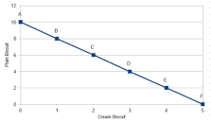
BUDGET LINE

Slide 18
Budget line
Budget = (Px1Qx2) + (Py1Qy2)
Let P be Price and Q be Quantity
X1,2 be Mangoes and Y1,2 be Oranges
Mangoes
Let X1 be Quantity of Mangoes and X2 be Price of Mangoes
Using S/N 1
X1 X2 = (100)(3) = 300

Slide 19
Oranges
Let Y1 be Quantity of Oranges and Y2 be Price of Oranges
Using S/N 1
Y1 Y2 = (0)(50) = 0
Z = X1 X2 + Y1 Y2
Z = (3)(100) + (0)(50)
300 = Income

Slide 20
CALCULATIONS CONT..
Price for mangoes =100 (Q) (30)
Price for oranges = 50 (Y) (0)
300 = 100Q + 50Y
6 = 2Q + Y
Y = 0 , Q = 3
6 =2Q + 0
6 = 2Q
Q =3
Q =0 Y=6
6 = 2(0) + Y and 6 = Y
Y = 6
Q =3
Z = 300

Slide 21
CONT…
M = PX.QX + PY.QY
P = Price and Q = Quantity
X = Commodity X and Y = Commodity Y
M = Income

Slide 22
The Effects of Changes in Income and Prices
The Budget Line can shift in a particular direction in certain circumstances.
The two circumstances that can influence this line are a change in the consumer's income and a change in the price of one/both goods.
Let us analyse both of these factors in greater detail below:
Increase in income – Suppose there is an increase in the consumer's income, but the prices of goods remain unchanged.
It will increase their capacity to buy more goods and the consumer has the option to purchase a greater quantity of the same commodity.
This increase in a consumer's income will shift the Budget Line in a rightward direction.
.

Slide 23
Let us analyse both of these factors in greater detail below
Decrease in income – Suppose there is a decrease in a consumer's income, but the prices of goods remain unchanged.
It will decrease their capacity to buy more goods, and they will also have to contend with buying a lesser quantity of the same commodity.
This decrease in a consumer's income will shift the Budget Line in a leftward direction

Slide 24
CHANGE IN PRICE OF ONE COMMODITY
If the price of one product changes but everything else stays the same, it will also impact the Budget Line.
If the price of one product falls, the consumer will have the option to purchase more units of that product.
And if the market price of that same product goes up, the consumer will have to contend with buying fewer units of that product.

Slide 25
Change in price of both commodities
If the market price of both products decreases simultaneously, the consumer will be able to purchase more units for both items and the Budget Line will shift towards the right.
But if the prices of both products increase together, the consumer will have to purchase less of both commodities and the Budget Line will shift leftwards.
If the price of one commodity rises but the other one falls, the buyer can purchase more of the first product but will have to reduce the quantity of the second product.
This scenario will further affect the Budget Line.

Slide 26
Slope of the Budget Line
Chanda's income: K12, 000
Prices: Price for Fish = K40 per Fish, Price for Mango = K10 per mango
Let Fish be “X” and Mango be “Y” and Budget Equation is 40X + 10Y ≤ 12, 000
A. If Chanda spends all his income on fish, how many fish does he buy?
K12000/K40 = 300 Fish
B. If Chanda spends all his income on mangos, how many mangos does he buy?
K12000/K10 = 1200 Mangos

Slide 27
Slope of the Budget Line
C. If Chanda buys 100 fish, how many mangos can he buy?
Fish cost K40 (K40 X 100) = K4000
Meaning K8000 has remained and it will buy 800 mangos (8000/10 ) = 800 Mangos
D. Plot each of the bundles from parts A to C on a graph that measures fish on the horizontal axis (X-axis) and mangos on the vertical (Y-axis) connect the dots.

Slide 28
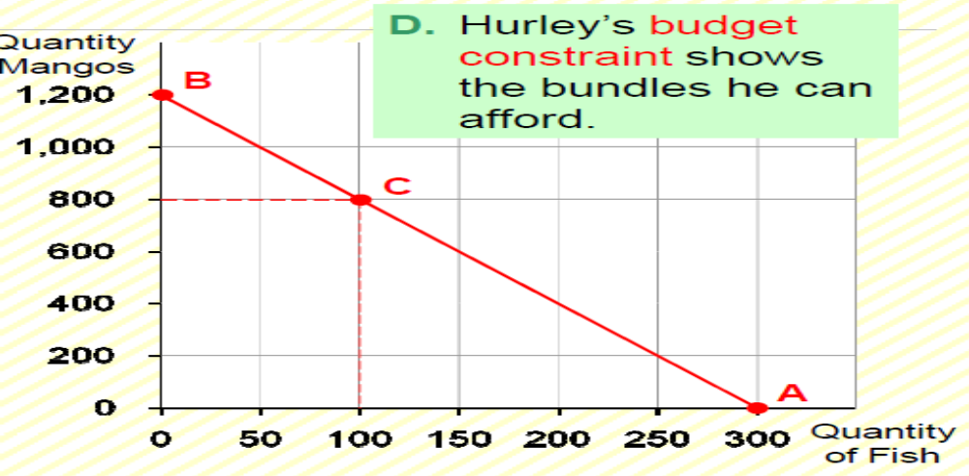
Slope of the Budget Line

Slide 29
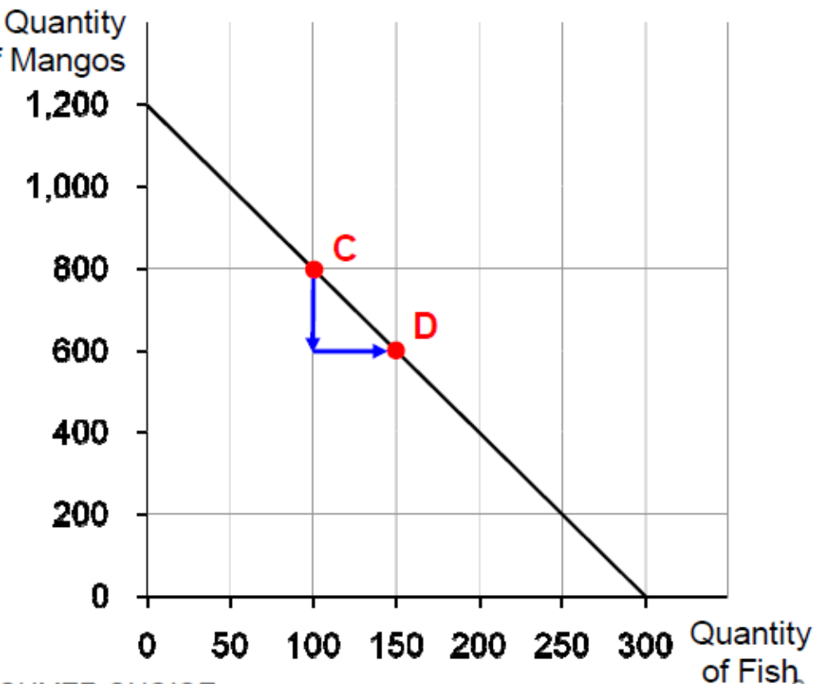
The Slope of the Budget Line
Slope = (600 −800) / (150−100) = − 200 / 50 = - 4

Slide 30
Consumers Equilibrium
Consumer equilibrium refers to a situation, in which a consumer derives maximum satisfaction, with no intention to change it and subject to given prices and his given income. The point of maximum satisfaction is achieved by studying indifference map and budget line together.
In order to display the combination of two goods X and Y, that the consumer buys to be in equilibrium, let's bring his indifference curves and budget line together.
Indifference Map: shows the consumer's preference scale between various combinations of two goods
Budget Line: depicts various combinations that he can afford to buy with his money income and prices of both the goods.

Slide 31
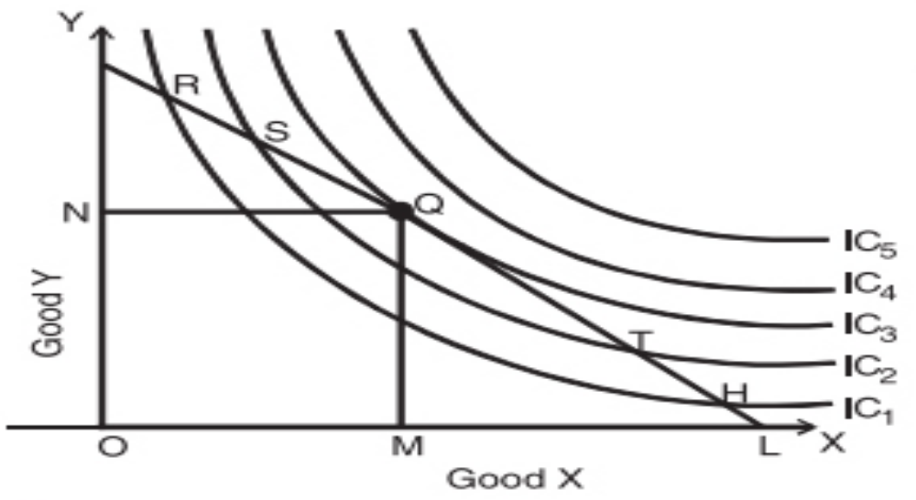
Consumers Equilibrium
In the following figure, we depict an indifference map with five indifference curves IC1, IC2, IC3, IC4, and IC5 along with the budget line for good X and good Y.

Slide 32
Consumers Equilibrium
The combinations R, S, Q, T, and H cost the same to the consumer. In order to maximize his level of satisfaction, the consumer needs to reach the highest indifference curve.
Since the consumer has assumed a budget constraint, he will be forced to remain on the budget line.
On an indifference map, higher indifference curve represents a higher level of satisfaction than any lower indifference curve.
So, a consumer always tries to remain at the highest possible indifference curve, subject to his budget constraint.

Slide 33
Let say, a consumer chooses the combination at point Q
This is the best choice since Q lies on his budget line and puts the consumer on the highest possible indifference curve, IC3. While there are higher curves, IC4 and IC5, they are beyond his budget. Therefore, he reaches the equilibrium at point Q on curve IC3.
Notice that at this point, the budget line PL is tangential to the indifference curve IC3. Also, in this position, the consumer buys OM quantity of X and ON quantity of Y.
Since point Q is the tangent point, the slopes of line PL and curve IC3 are equal at this point. Further, the slope of the indifference curve shows a marginal rate of substitution of X for Y (MRSxy) equal to 𝑀𝑈x /𝑀𝑈𝑦.
Also, the slope of the price line (PL) indicates the ratio between

Slide 34
Conditions of Consumer's Equilibrium
The consumer's equilibrium under the indifference curve theory must meet the following two conditions:
(i) MRS (Marginal Rate of Substitution) XY = Ratio of prices or 𝑷𝑿/𝑷𝒀
Let the two goods be X and Y. The first condition for consumer's equilibrium is that
MRSXY = PX/PY
a. If MRSXY > 𝑷𝑿/𝑷𝒀, it means that the consumer is willing to pay more for X than the price prevailing in the market. As a result, the consumer buys more of X. As a result, MRS falls till it becomes equal to the ratio of prices and the equilibrium is established.

Slide 35
CONT…
b. If MRSXY < 𝑷𝑿/𝑷𝒀, it means that the consumer is willing to pay less for X than the price prevailing in the market. It induces the consumer to buys less of X and more of Y. As a result, MRS rises till it becomes equal to the ratio of prices and the equilibrium is established.
(ii) MRS continuously falls
The second condition for consumer‟s equilibrium is that MRS must be diminishing at the point of equilibrium, i.e. the indifference curve must be convex to the origin at the point of equilibrium. Unless MRS continuously falls, the equilibrium cannot be established.
Thus, both the conditions need to be fulfilled for a consumer to be in equilibrium.

Slide 36
Example
The table given below is an example of expenditure plan and the graph that follows is its presentation on graph. Given: Budget of the consumer is K10, Price of good X is K1 each and Price of good Y is K2 each.
Combination Units of good Y (K2) Units of good X (K1)
A 5 0
C 4.5 1
E 3 4
D 1.5 7
B 0 10

Slide 37
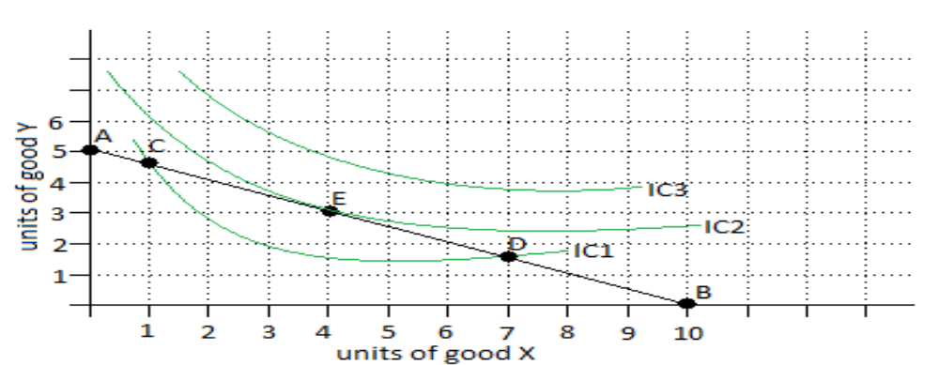
Presentation on graph
In the given diagram, we can see IC1, IC2 and IC3 are three different indifference curves and AB is a budget line. A consumer can only consume such combinations of goods which lie upon the budget line at a given income level and constant price of goods X and Y.

Slide 38
Applications of elasticity in consumer behavior analysis
1.Pricing Strategies
Businesses use PED to determine optimal prices for their products. If PED is high, a price increase will lead to a significant decrease in demand.
2. Demand Forecasting
Elasticity helps businesses predict how changes in price, income, or other factors will affect demand.
3. Advertising and Marketing
By understanding the elasticity of demand, businesses can tailor their advertising and marketing efforts to specific consumer groups.
4. Public Policy
Policymakers use elasticity to evaluate the impact of taxes, subsidies, and other policies on consumer behaviour.

Slide 39
Real-World Examples:
1. Tobacco Taxation
Studies have shown that increasing tobacco taxes leads to a significant decrease in demand, particularly among low-income smokers (PED = -0.4)
2. Electric Vehicle Adoption: Research has found that the demand for electric vehicles is highly elastic with respect to income (income elasticity = 2.5)

Slide 40
Revealed preference theory and consumer demand
This theory, developed by Paul Samuelson, states that a consumer's preferences can be revealed through their purchasing decisions. By observing a consumer's choices, we can infer their preferences.
Key Assumptions
Consistency
Consumers make consistent choices.
2. Rationality
Consumers make rational decisions based on their preferences.
3. Transitivity
If a consumer prefers A over B and B over C, they will prefer A over

Slide 41
Revealed Preference and Demand
By analysing a consumer's revealed preferences, we can:
1. Derive Demand Curve
Plot the consumer's choices to derive their demand curve.
2. Analyse Demand Elasticity
Measure how responsive demand is to changes in price or other factors.
3. Understand Consumer Behaviour
Gain insights into consumer preferences and decision-making processes.
Example: Suppose we observe a consumer's purchases:
Price Quantity Demanded
$10 2 units
$8 3 units
$12 1 unit
By analysing these choices, we can derive the consumer's demand curve and understand their preferences and decision-making processes

Slide 42
Demand Curve
Plotting the data points on a graph, we can derive the demand curve:
The demand curve shows the inverse relationship between price and quantity demanded. As the price increases, the quantity demanded decreases.
Preference and Decision Making:
Based on the demand curve, we can infer the consumer's preferences and decision-making process:
Diminishing Marginal Utility: The consumer's marginal utility decreases as they consume more units. This is evident from the decreasing quantity demanded as the price increases.
Rational Choice: The consumer makes rational choices by purchasing more units when the price is lower ($8) and fewer units when the price is higher ($12).
Budget Constraint: The consumer's budget constraint is evident from the fact that they purchase more units at a lower price and fewer units at a higher price.

Slide 43
Indifference Curve Analysis:
To further analyse the consumer's preferences, we can draw indifference curves. Indifference curves represent the consumer's willingness to trade off one good for another.
Assuming the consumer's income is $32 (2 units * $10 + 1 unit * $12), we can draw the following indifference curves:
The indifference curves show the consumer's willingness to trade off units of the good for other goods or services.
Therefore,
By analysing the demand curve and indifference curves, we can understand the consumer's preferences and decision-making process. The consumer makes rational choices based on their budget constraint and diminishing marginal utility

Slide 44
Behavioral economics insights into consumer decision-making
A vital area of study that connects conventional economic theory with the psychological facts of human decision-making is behavioral economics.
Behavioral economics acknowledges that real-world decision-making is frequently influenced by
Cognitive biases, emotions, and social influences.
This is in contrast to classical economics, which holds that consumers are perfectly rational actors who make decisions based only on objective utility maximization.
Understanding consumer behavior from this perspective is crucial because it shows that decisions are not always made in the most rational or cost-effective ways.

Slide 45
1. Cognitive Biases in the Making of Consumer Decisions
Cognitive biases are regular patterns of judgmental deviance from rationality that frequently result in consumers making less-than-ideal choices. These biases influence how consumers perceive information and make decisions.
2. How Emotions Affect Consumer Decisions
Consumer decision-making is heavily influenced by emotions, which can lead to decisions that contradict logical economic models. Behavioral economics recognizes the impact of emotions like fear, happiness, and regret in decision-making, in contrast to classic economic theories that presume decisions are made only on the basis of logic

Slide 46
3. Consumer Behavior and the Effects of Framing
The phenomenon known as "framing effects" describes how the presentation of information affects the choices that people make. When two products have the same ingredients, but one is labeled "90% fat-free" and the other "10% fat," for instance, customers could react to them differently. This effect serves as an example of how minor adjustments to presentation can have a big impact on decisions and perceptions.
4. Social Factors Affecting Consumer Choice
Peer pressure, cultural standards, and other social variables are important in determining how consumers behave. When making judgments, people frequently turn to one another, particularly in ambiguous circumstances. This can result in phenomena like conformity or herd behavior.

Slide 47
5. Consequences for Policy Design and Marketing
Designing policies and marketing tactics will be significantly impacted by the insights gleaned from behavioral economics.
By presenting products in ways that play on consumer prejudices or exploiting loss aversion to induce timely purchases, marketers can create more effective campaigns that appeal to consumers' psychological proclivities.
Similarly, by utilizing behavioral insights, governments can create programs that encourage consumers to make healthier or more environmentally friendly decisions.

Slide 48
Ethical considerations in advertising and consumer choices
Deception
Misleading or false claims about a product or service.
2. Manipulation
Using persuasive tactics to exploit consumers' emotions or vulnerabilities.
3. Targeting vulnerable groups
Advertising to children, the elderly, or other susceptible groups.
4. Cultural sensitivity
Using stereotypes, biases, or insensitive imagery.

Slide 49
Ethical Considerations in Consumer Choice:
1. Informed decision-making
Consumers' right to accurate and unbiased information.
2. Autonomy
Consumers' freedom to make choices without undue influence.
3. Privacy
Protection of consumers' personal data and online behaviour.
4. Social responsibility
Considering the environmental, social, and ethical implications of purchasing decisions.
Regulations and Guidelines
1. Federal Trade Commission (FTC)
Regulates deceptive advertising practices in the United States.
2. Advertising Self-Regulatory Council (ASRC)
Promotes truthful and transparent advertising.
3. International Chamber of Commerce (ICC)
Develops global advertising standards.

Slide 50
The role of consumer psychology in marketing strategies
Segmentation: Using consumer psychology to identify and target specific consumer groups.
Positioning: Creating a unique brand identity that resonates with consumers' values and attitudes.
Branding: Developing brand personalities that appeal to consumers' emotions and needs.
Advertising: Crafting persuasive messages that tap into consumers' motivations and desires.
Product Development: Designing products that meet consumers' needs, wants, and expectations.

Slide 51
Real-World Examples
Apple's Branding Strategy
Apple's focus on innovation, design, and customer experience has created a loyal customer base.
Coca-Cola's Advertising
Coca-Cola's "Share a Coke" campaign successfully tapped into consumers' desire for personalization and social connection.
Benefits:
Increased Customer Loyalty
By understanding consumers' needs and desires, businesses can create loyal customer bases.
Improved Brand Reputation
Effective application of consumer psychology can enhance brand reputation and credibility.
Enhanced Marketing Effectiveness
Consumer psychology helps businesses develop targeted and persuasive marketing strategies.

Slide 52
The impact of technological advancements on consumer behavior
Technological advancements have significantly impacted consumer behaviour, transforming the way people shop, interact with brands, and make purchasing decisions.
KEY IMPACTS
Increased convenience: E-commerce, mobile shopping, and digital payment systems have made shopping more convenient and accessible.
Improved product information: Online reviews, ratings, and product comparisons have empowered consumers to make informed purchasing decisions.
Personalization: Data analytics and AI-powered recommendation engines enable businesses to offer personalized products, services, and experiences.
Social influence: Social media platforms have amplified the influence of peer recommendations, reviews, and user-generated content on consumer behaviour.
Changing shopping habits: Technological advancements have led to the rise of Omni channel retailing, where consumers seamlessly shift between online and offline channels.

